Slide 1
Neural Networks
BY UMANG KEJRIWAL

Slide 2
What we will cover?
Neurons or Perceptrons
Activation Functions
Cost Function
Backpropogation
Gradient Descent
© UMANG KEJRIWAL

Slide 3
Neurons / Perceptron
Very important part of brain through which the signals are transmitted.
Artificial Neural Network is based on Natural Biological Systems.
ANN is a software based approach to replicate the biological neurons.
Let’s discuss about Biological Neurons !!
© UMANG KEJRIWAL

Slide 4
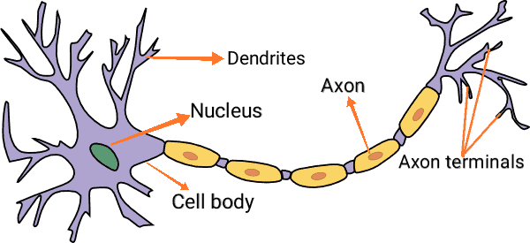
Biological Neurons
© UMANG KEJRIWAL

Slide 5
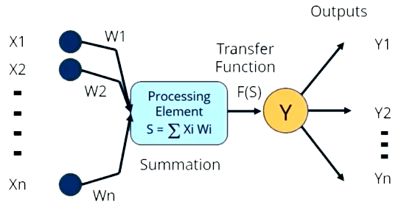
Artificial Neurons
Bias
© UMANG KEJRIWAL

Slide 6

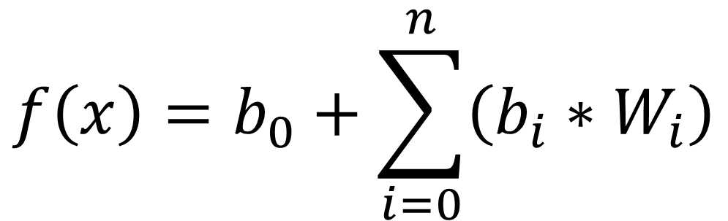


Perceptron Mathematical Model
$$f\left(x\right)=b_{0}+\sum_{i=0}^{n}{\left(b_{i}∗W_{i}\right)}$$
$$b_{i}$$
= inputs
$$W_{i}$$
= Weights
$$b_{0}$$
= bias
© UMANG KEJRIWAL

Slide 7
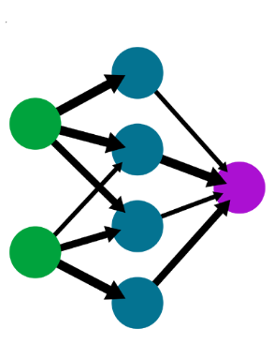
Multiple Perceptron Networks
INPUT LAYER
OUTPUT LAYER
HIDDEN LAYER
© UMANG KEJRIWAL

Slide 8
Activation Functions
Main role is to calculate and decides the output.
Types –
Step Function
Sigmoid Function
Hyperbolic Tangent
Rectified Linear Unit (ReLU)
Let’s discuss about these one by one !!
© UMANG KEJRIWAL

Slide 9
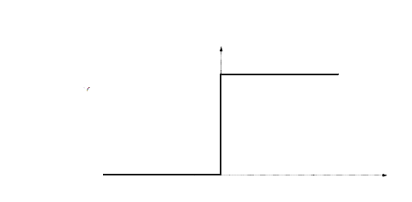
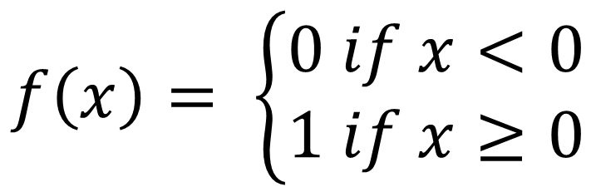
Step Function
1
$$f\left(x\right)= \left\{\begin{aligned}0 if x<0 \\ 1 if x≥0\end{aligned}\right.$$
0
© UMANG KEJRIWAL

Slide 10
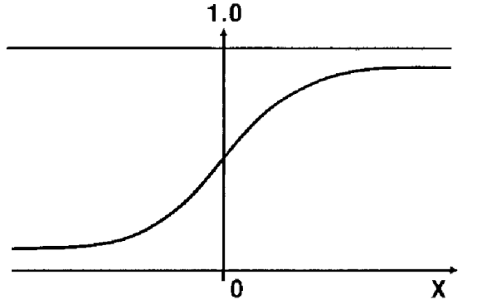
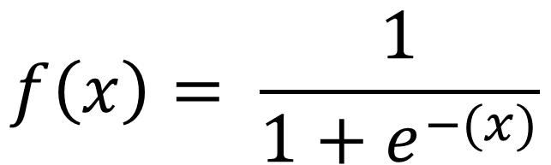
Sigmoid Function
$$f\left(x\right)= \frac{1}{{1+e}^{−(x)}}$$
© UMANG KEJRIWAL

Slide 11
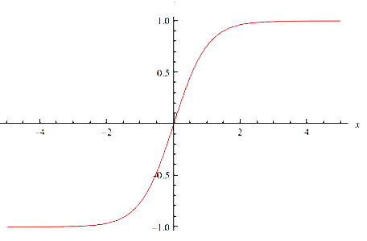
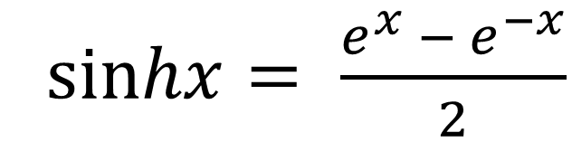
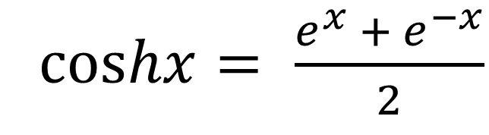
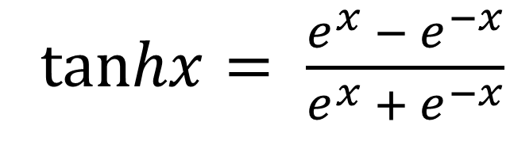
Hyperbolic Tangent Function
cos$hx= \frac{e^{x} + e^{−x}}{2}$
sin$hx= \frac{e^{x} − e^{−x}}{2}$
tan$hx= \frac{e^{x} − e^{−x}}{e^{x} + e^{−x}}$
© UMANG KEJRIWAL

Slide 12
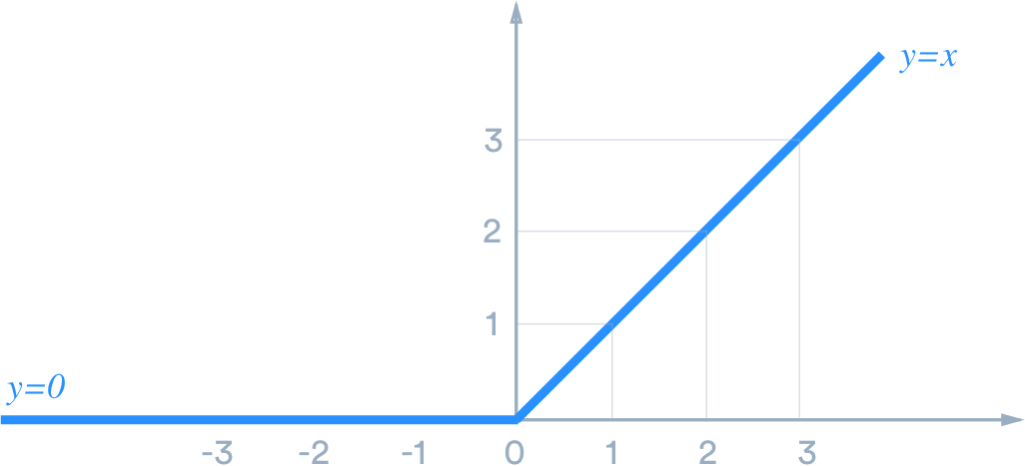
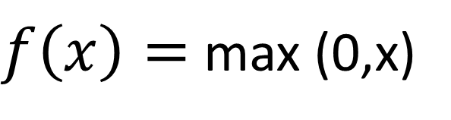
Rectified Linear Unit (ReLU) Function
$f\left(x\right)=$ max (0,x)
© UMANG KEJRIWAL

Slide 13
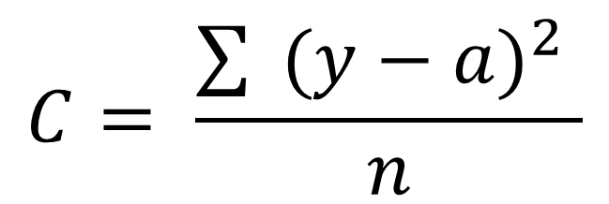
Cost Function
It calculates difference between the actual and predicted values, i.e. it calculates the error.
$$C= \frac{\sum{ {(y−a)}^{2} }}{n}$$
y = actual values
a = predicted values
It has one drawback as it slows down the learning of neural network, So in this case we use “Cross Entropy”
© UMANG KEJRIWAL

Slide 14
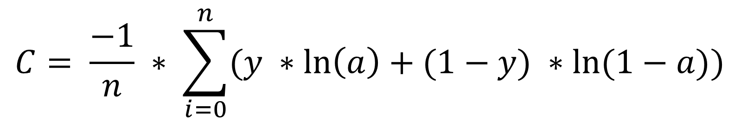
Cross Entropy
It reduces the cost function and increases the learning of neural network.
$$C= \frac{−1}{n} ∗ \sum_{i=0}^{n}{(y ∗\ln\left(a\right)+(1−y)} ∗\ln{(1−a))}$$
y = actual values
a = predicted values
© UMANG KEJRIWAL

Slide 15
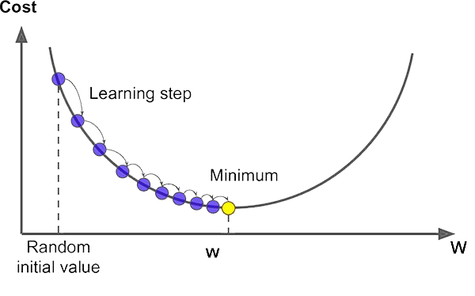
Gradient Descent
It is an optimization algorithm for finding the minimum value of a function to reduce cost.
© UMANG KEJRIWAL

Slide 16
Back-Propagation
It is simply a revision of weights.
In this using Feed Forward Network, weights are changed till we get the lease cost function (error)
© UMANG KEJRIWAL

